Slide 1
Centralized wPRF (packed)
Files:
PRF.cpp
PackedMod2.hpp
PackedMod2.hpp
methods | No.of times | Cost for each call | Total call
toeplitzByVec | 1 | 25n | 25n
toArray | 1 | 2n | 2n
fromArray | 1 | 8n | 8n
matByVec | 1 | 37n | 37n
Total | 3 |  | ~72n = 18,432

Slide 2
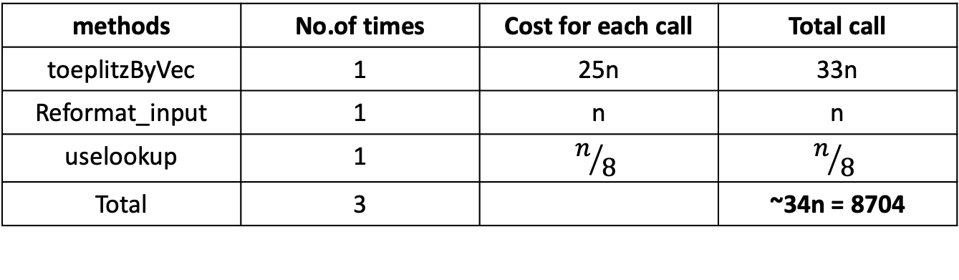
Centralized wPRF (packed + lookup table)
Files:
test_packed_PRF_central_lookup.cpp
lookup_functions.cpp
PackedMod2.hpp
methods | No.of times | Cost for each call | Total call
toeplitzByVec | 1 | 25n | 33n
Reformat_input | 1 | n | n
uselookup | 1 | $$n/8$$ | $$n/8$$
Total | 3 |  | ~34n = 8704

Slide 3
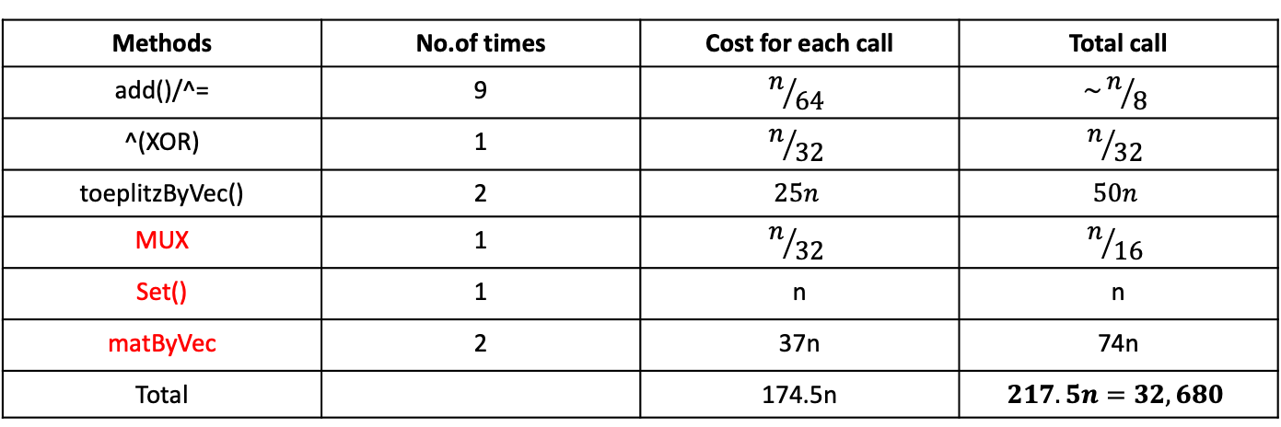
TCC’18 with packed-wrong
Files:
PRF.cpp
Toeplitz-by-x.cpp
OT.cpp
PackedMod2.hpp
Methods | No.of times | Cost for each call | Total call
add()/^= | 9 | $$n/{64}$$ | $$\sim n/8$$
^(XOR) | 1 | $$n/{32}$$ | $$n/{32}$$
toeplitzByVec() | 2 | $$25n$$ | $$50n$$
MUX | 1 | $$n/{32}$$ | $$n/{16}$$
Set() | 1 | n | n
matByVec | 2 | 37n | 74n
Total |  | 174.5n | $$217.5n=32,680$$

Slide 4
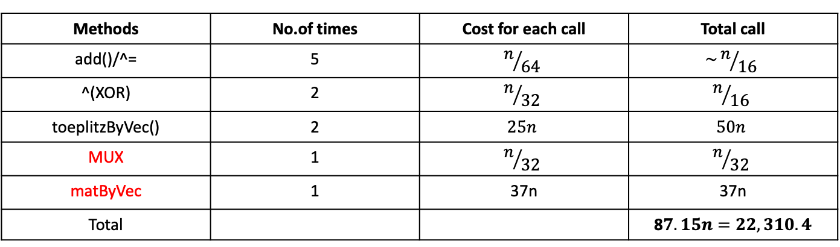
Fully Distributed with packed
Files:
new_protocol.cpp
PackedMod2.hpp
PackedMod3.hpp
Methods | No.of times | Cost for each call | Total call
add()/^= | 5 | $$n/{64}$$ | $$\sim n/{16}$$
^(XOR) | 2 | $$n/{32}$$ | $$n/{16}$$
toeplitzByVec() | 2 | $$25n$$ | $$50n$$
MUX | 1 | $$n/{32}$$ | $$n/{32}$$
matByVec | 1 | 37n | 37n
Total |  |  | 8$7.15n=22,310.4$

Slide 5
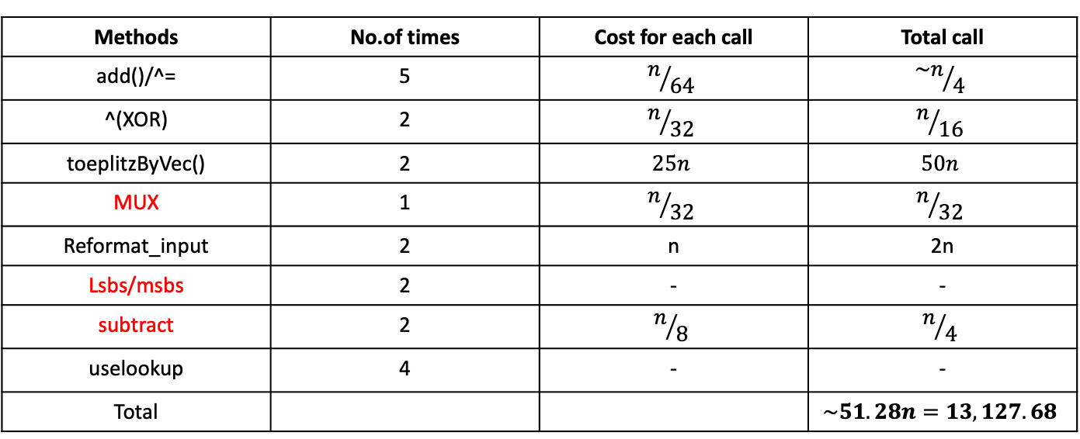
Fully Distributed with packed and lookup
Files:
new_protocol.cpp
lookup_functions.cpp
PackedMod2.hpp
PackedMod3.hpp
Methods | No.of times | Cost for each call | Total call
add()/^= | 5 | $$n/{64}$$ | $${\sim n}/4$$
^(XOR) | 2 | $$n/{32}$$ | $$n/{16}$$
toeplitzByVec() | 2 | $$25n$$ | $$50n$$
MUX | 1 | $$n/{32}$$ | $$n/{32}$$
Reformat_input | 2 | n | 2n
Lsbs/msbs | 2 | - | -
subtract | 2 | $$n/8$$ | $$n/4$$
uselookup | 4 | - | -
Total |  |  | $$\sim 51.28n=13,127.68$$

Slide 6
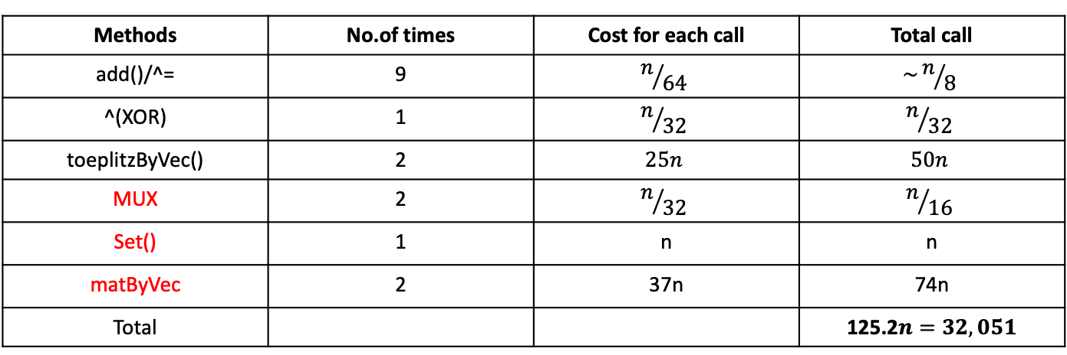
oPRF (packed)
Files:
OPRF.cpp
PackedMod2.hpp
PackedMod3.hpp
Methods | No.of times | Cost for each call | Total call
add()/^= | 9 | $$n/{64}$$ | $$\sim n/8$$
^(XOR) | 1 | $$n/{32}$$ | $$n/{32}$$
toeplitzByVec() | 2 | $$25n$$ | $$50n$$
MUX | 2 | $$n/{32}$$ | $$n/{16}$$
Set() | 1 | n | n
matByVec | 2 | 37n | 74n
Total |  |  | 125.2$n=32,051$

Slide 7
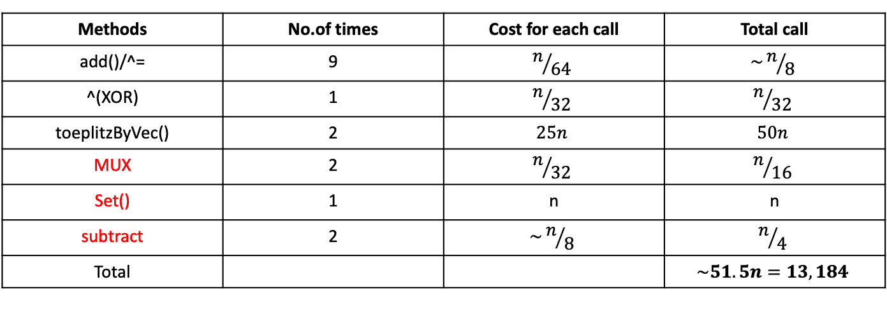
oPRF (packed + lookup)
Files:
OPRF.cpp
lookup_function.cpp
PackedMod2.hpp
PackedMod3.hpp
Methods | No.of times | Cost for each call | Total call
add()/^= | 9 | $$n/{64}$$ | $$\sim n/8$$
^(XOR) | 1 | $$n/{32}$$ | $$n/{32}$$
toeplitzByVec() | 2 | $$25n$$ | $$50n$$
MUX | 2 | $$n/{32}$$ | $$n/{16}$$
Set() | 1 | n | n
subtract | 2 | $$\sim n/8$$ | $$n/4$$
Total |  |  | $$\sim 51.5n=13,184$$

Slide 8

DIDO(Fully Distributed with packed)
party1_round_1: 9 operations
Party2_round_1: same
Both K, $Rk_{1}$ are Toeplitz

